Slide 1
AI MINI PROJECT
BY
G.HASINI CHOWDARY ENG22AM0176
VIKAS S ENG22AM0200
KUSHAL.J.R ENG22AM0178
SECTION-C
SUBMITTED TO
Prof.Pradeep Kumar K

Slide 2
INTRODUCTION
The Project focuses on leveraging AI techniques to extract valuable insights from product reviews, aiding businesses and consumers in making informed decisions and aim to develop a machine learning model that can analyze and generate insightful reviews for various products based on user input or existing reviews. This project leverages natural language processing (NLP) techniques to understand and interpret textual data, allowing the AI model to generate coherent and contextually relevant product reviews.
Features of the project :
Contextual Understanding: Develop the ability to understand the context of the product reviews, considering factors like user preferences, product category, and industry-specific jargon.
Summary Generation: Create a concise summary of the input text, highlighting the most important points, opinions, and sentiments expressed by the user or in existing reviews.
Sentiment Analysis: The AI model should be able to determine the overall sentiment of the input text, indicating whether the user is expressing a positive, negative, or neutral opinion about the product.
.

Slide 3
Feature Extraction: Identify and extract key features or attributes of the product mentioned in the input text. This could include aspects such as performance, design, usability, durability, etc. User Interaction: Implement a userfriendly interface that allows users to input text or provide links to existing reviews. The AI system should then process this input and generate the desired output, whether it's a sentiment analysis, feature extraction, or summary Useful technologies: Machine Learning Algorithms: Implement machine learning algorithms, such as supervised learning for sentiment analysis or unsupervised learning for feature extraction. Natural Language Processing (NLP): Utilize NLP techniques and libraries to process and analyze textual data, extract features, and understand the context of product reviews. User Interface (UI): Design a simple and intuitive user interface, possibly using frameworks like Flask or Django for web applications or Tkinter for desktop application. Python Programming Language: Develop the project using Python, leveraging popular libraries like NLTK, spaCy, or TensorFlow for NLP tasks.

Slide 4
OBJECTIVE
The primary objective of this mini project is to create an AI system that can assist users in generating product reviews or summarizing existing reviews. The model should be capable of understanding the sentiment, key features, and opinions expressed in the input text related to a particular product. It should be able to do the following: -Assess the product's features, functionality, and overall performance. -Identify and communicate the product's strengths and weaknesses which allow manufacturers to identify areas for improvement. -Collect feedback from users to understand their experiences with the product. This information can be valuable for both consumers and manufacturers in refining and enhancing products. By achieving these objectives, the AI Mini Project on 'Product Review' aims to showcase the practical applications of artificial intelligence in improving decision-making processes based on customer feedback and opinions.

Slide 5
PROJECT DESCRIPTION
In the era of online shopping and e-commerce, customer reviews play a pivotal role in influencing purchasing decisions. The AI Mini Project on 'Product Review' aims to develop a sophisticated system that utilizes artificial intelligence techniques to extract meaningful insights from product reviews, helping businesses and consumers make informed choices. A functional AI system capable of accurately analyzing product reviews for sentiment, features, and overall rating. An intuitive user interface that allows users to interact with the system easily. Insights into customer sentiments and preferences, aiding businesses in improving product quality and marketing strategies. Practical demonstration of AI's applicability in the domain of customer feedback analysis. By successfully implementing these components, the AI Mini Project on 'Product Review' seeks to showcase the power of AI in extracting actionable insights from the vast amount of customer-generated content available online.

Slide 6
PROBLEM STATEMENT
How to conclude the status of a product efficiently with the help of reviews from the customers.
LITERATURE REVIEW
Here is a concise literature survey focusing on key aspects of sentiment analysis, feature extraction, and rating prediction in the context of product reviews:
Sentiment Analysis:
Paper: Pang, B., & Lee, L. (2008). Opinion Mining and Sentiment Analysis.
Summary: This seminal paper provides an overview of sentiment analysis techniques, including the challenges and applications. It discusses various approaches, from rule-based methods to machine learning-based approaches, providing a foundation for sentiment analysis in product reviews.
Paper: Liu, B. (2012). Sentiment Analysis and Opinion Mining.
Summary: Liu's comprehensive survey delves into sentiment analysis and opinion mining, covering topics such as sentiment lexicons, machine learning approaches, and challenges in sentiment analysis. It serves as a valuable resource for understanding the nuances of sentiment analysis.

Slide 7
Feature Extraction:
Paper: Mikolov, T., et al. (2013). Distributed Representations of Words and Phrases and their
Compositionality.
Summary: This paper introduces Word2Vec, a popular technique for word embedding.
Understanding word embeddings is crucial for feature extraction in natural language processing
tasks, including the identification of key features in product reviews.
Paper: Collobert, R., et al. (2011). Natural Language Processing (Almost) from Scratch.
Summary: Collobert et al. discuss deep learning approaches for natural language processing tasks,
emphasizing the importance of feature learning. Deep learning models can be explored for
feature extraction from product reviews.
Rating Prediction:
Paper: McAuley, J., & Leskovec, J. (2013). Hidden Factors and Hidden Topics: Understanding Rating
Dimensions with Review Text.
Summary: The paper explores the correlation between review text and product ratings. It
discusses the use of latent factors and topics in predicting ratings, providing insights into how
textual information can enhance rating prediction models.
Paper: Lu, Y., et al. (2009). How Does the Online Consumer Review System Influence Marketing
Decision Making? A Review.

Slide 8
Summary: This paper explores the impact of online consumer reviews on decision-making. It emphasizes the importance of reviews in predicting consumer behavior and provides insights into incorporating review information for rating prediction.
Overall Product Review Analysis:
Paper: Ganu, G., et al. (2009). Beyond the Stars: Improving Rating Predictions using Review Text Content.
Summary: This paper investigates the integration of review text content for improving rating predictions. It discusses the limitations of using only numerical ratings and advocates for leveraging textual 9 information in rating prediction models.
Paper: Kim, S. M., & Hovy, E. (2004). Determining the Sentiment of Opinions.
Summary: Kim and Hovy present an approach for determining the sentiment of opinions, which can be valuable in the context of overall product review analysis. The paper discusses the challenges of sentiment classification and proposes solutions
.

Slide 9
ALGORITHM
1.Data Collection: Collect a diverse dataset of product reviews from different sources, ensuring it covers a wide range of products and sentiments.
2. Data Preprocessing: Perform text preprocessing techniques, such as removing stopwords, handling punctuation, and converting text to lowercase. Apply techniques like stemming or lemmatization to normalize the text.
3. Sentiment Analysis: Build a sentiment analysis model using machine learning or deep learning techniques. Explore algorithms like Naive Bayes, Support Vector Machines, or Recurrent Neural Networks (RNNs) for sentiment classification. Train the model using the preprocessed dataset and labeled sentiment labels.
4. Model Evaluation: Evaluate the performance of the sentiment analysis model using appropriate evaluation metrics, such as accuracy, precision, recall, and F1-score. Split the dataset into training and testing sets to assess the model's generalization capability.
5. User Interface: Develop a user interface that allows users to input product reviews and visualize the sentiment analysis results. The interface should be intuitive, visually appealing, and provide clear insights into the sentiment of the reviews

Slide 10
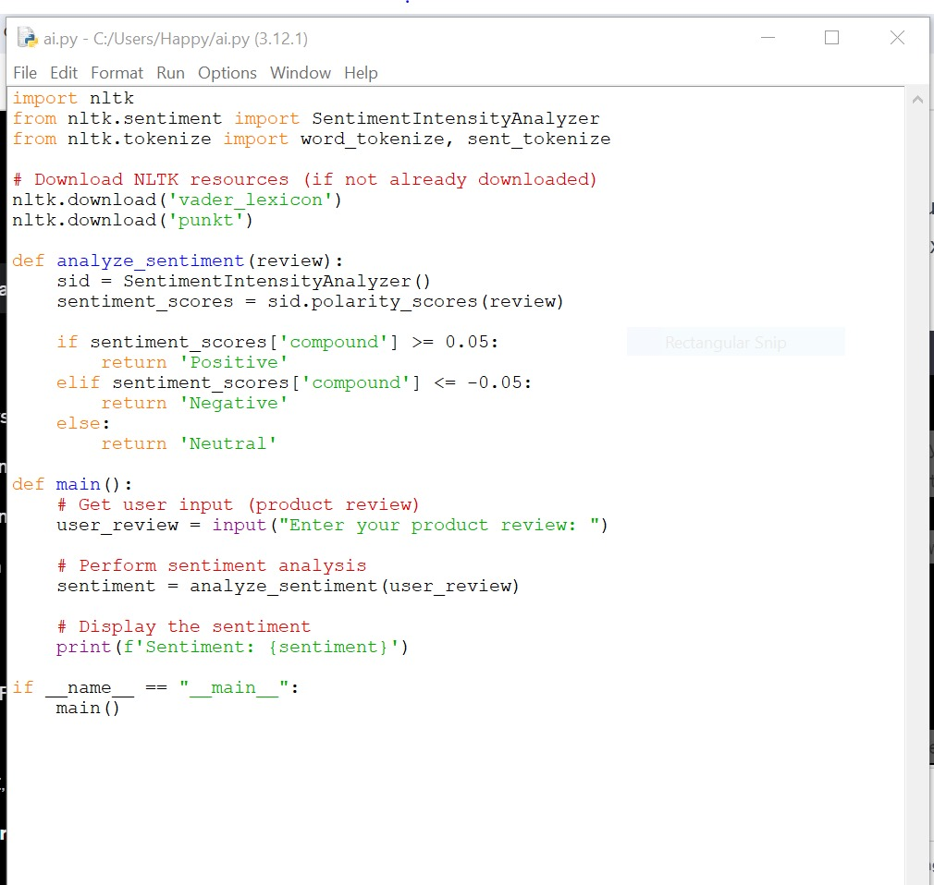

PROGRAM:

Slide 11
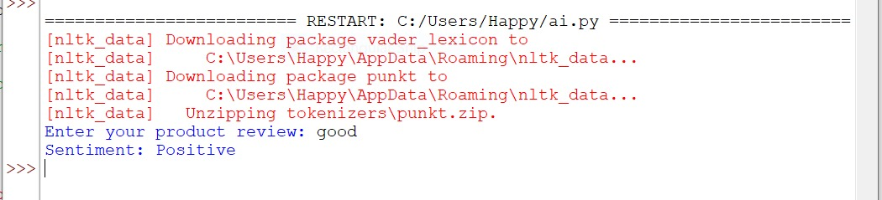
OUTPUT
CONCLUSION:
The project on 'Product Review' demonstrates the practical application of artificial intelligence in extracting actionable insights from the wealth of customer-generated content available online. The combination of sentiment analysis, feature extraction, and rating prediction offers businesses a holistic view of customer sentiments, empowering them to make informed decisions and enhance their products and services.

Slide 12
THANK YOU

